Slide 1

RUNGTA COLLEGE OF DENTAL SCIENCES AND RESEARCH
Endodontic instruments
DEPARTMENT OF CONSERVATIVE DENTISTRY AND ENDODONTICS

Slide 2
Specific learning Objectives
At the end of this presentation the learner is expected to know ;
Core areas* | Domain ** | Category #
History | Cognitive | Nice to know
Instruments used for obturation | Cognitive | Must know

Slide 3
Content
Standardization of Instruments given by Ingle and Levine
Classification of Endodontic Instruments
Group I Hand-operated Instruments
Files
Group II Low Speed Instruments with Latch-Type Design
Group III Engine-Driven Instruments
Generations of NiTi Rotary Files
First Generation NiTi Rotary Files
Second Generation
Third Generation Files
Fourth Generation Reciprocating Instruments
Fifth Generation Instruments
Scout Race Files
Group IV Sonics and Ultrasonics in Endodontics
Sonic Handpiece
Instrument Deformation and Breakage
Instruments Used for Filling Root Canals

Slide 4
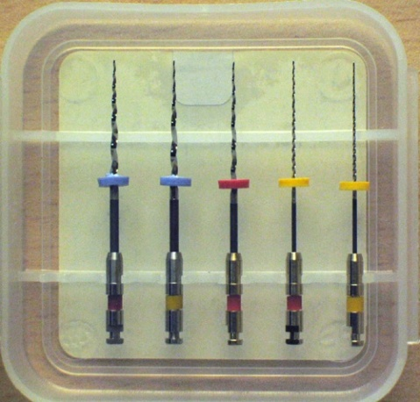
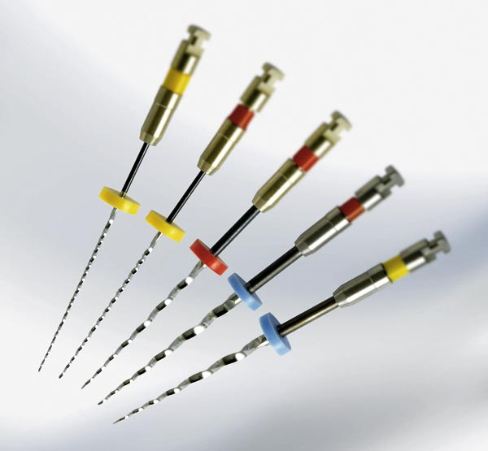
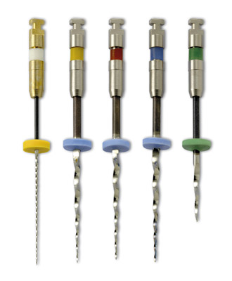
EndoWave
Kit A for normal root canals
Kit B is more suitable for preparing narrow and severely curved canals.
Cross Section |  | triangular
Radial Lands
Tip Type |  | safety tip
Rake Angle
RPM

Slide 5
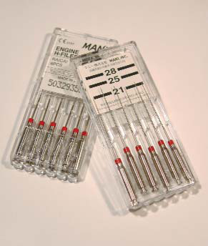
Mani NRT
Cross Section |  | modified rectangular shaped core
Radial Lands
Tip Type |  | Cutting tip
Rake Angle
RPM

Slide 6
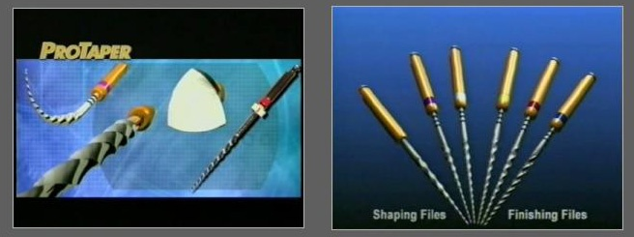
ProTaper
Cross Section |  | Convex Triangular three Edges
Radial Lands |  | No
Tip Type |  | Modified Active
Rake Angle |  | Positive
RPM |  | 250-350

Slide 7








ProTaper Universal
Cross Section |  | Convex Triangular three Edges
Radial Lands |  | No
Tip Type |  | Non-cutting Guiding tip
Rake Angle |  | Positive
RPM |  | 250-350

Slide 8



Flex Master
Cross Section |  | Convex Triangular three Edges
Radial Lands |  | No
Tip Type |  | Rounded Passive
Rake Angle |  | Positive
RPM |  | 150-300

Slide 9
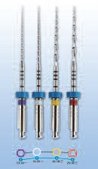
MTwo
Design characteristics of Mtwo Nickel-Titanium Files
• 'Single Length Technique'
Cross-section profile of an S-File
• 2 point wall contact due to above cross-section profile
• Large space for dentin removal
• Shortened instrument shaft
• Increasing space between cutting blades towards the coronal region
• Flattened instrument tip
Cross Section |  | S-shape Two Edges
Radial Lands |  | No
Tip Type |  | Flattened
Rake Angle |  | Positive
RPM

Slide 10
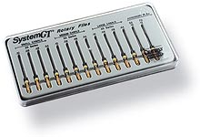

System GT
Cross Section |  | U-File Design
Radial Lands |  | Yes
Tip Type |  | Non-Cutting Rounded
Rake Angle |  | Positive
RPM |  | 150-350

Slide 11

Liberator System
Cross Section |  | Triangular
Radial Lands |  | No
Tip Type |  | Non-Cutting
Rake Angle |  | Negative
RPM |  | 1500-2000

Slide 12
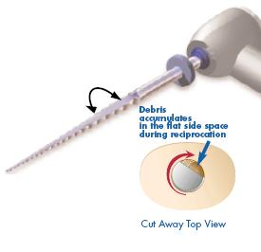
Safe Siders

Slide 13
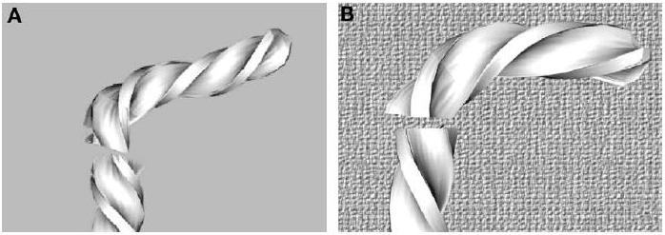
Disadvantages Of NiTi Instruments
Although stainless steel files often give a visual clue that stress has occurred, NiTi files fail without warning
Inspection of the files should be performed with magnification.
Fracture can occur from torsional or flexural fatigue
Bortnick KL, Steiman HR, Ruskin A: Comparison of NiTi file distortion using electric and air-driven handpieces, J Endod 27:57, 2001.
Nickel-titanium instruments fail at a lesser torque compared with stainless steel instruments of the same size.
Roane JB: Crown-down nickel-titanium and endodontics
Endod Pract 2:16, 1999.
Torsional Fracture
Fatigue Fracture

Slide 14
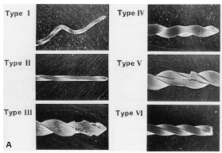
Sotokawa’s classification of instrument damage:
Type I- Bent instrument.
Type II- Stretching or straightening of twist contour.
Type III- Peeling-off metal at blade edges.
Type IV- Partial clockwise twist.
Type V- Cracking along axis.
Type VI- Full fracture.

Slide 15
INSTRUMENTS USED FOR
ROOT CANAL OBTURATION
Obturating Aids
Instruments to coat the canal
Instruments used for different techniques:
  Lateral condensation
  Vertical condensation
  Thermomechanical compaction
  Thermoplasticized techniques
    Injectable systems
    Core carrier based systems

Slide 16
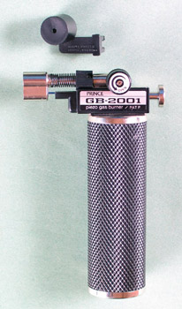
OBTURATING AIDS
Gas Burner

Slide 17

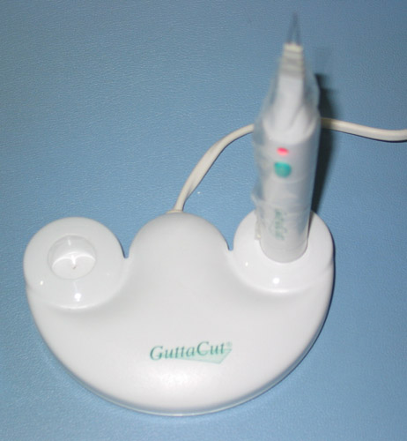
Gutta Cut
Therma Cut

Slide 18
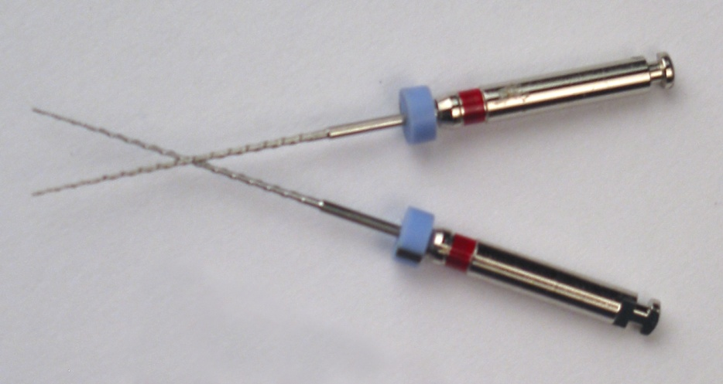
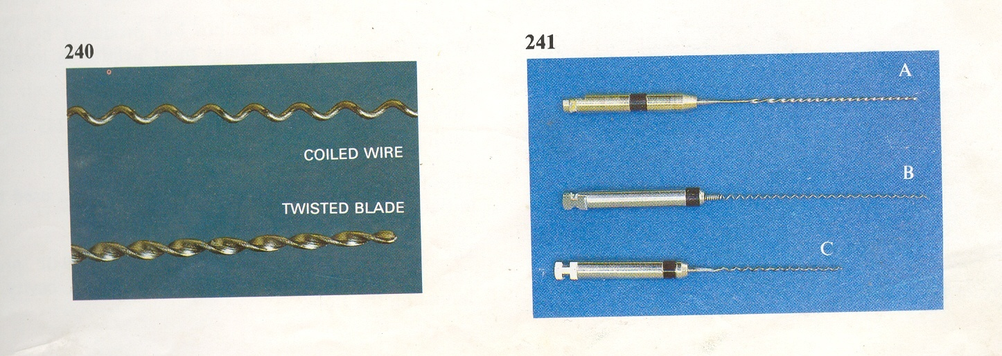
INSTRUMENTS TO COAT THE CANAL
BI-DIRECTIONAL SPIRALS
LENTULO SPIRALS
Used for
  Placing Initial Sealer With Solid Core Materials
  Completely Filling The Canal With Paste Filling

Slide 19
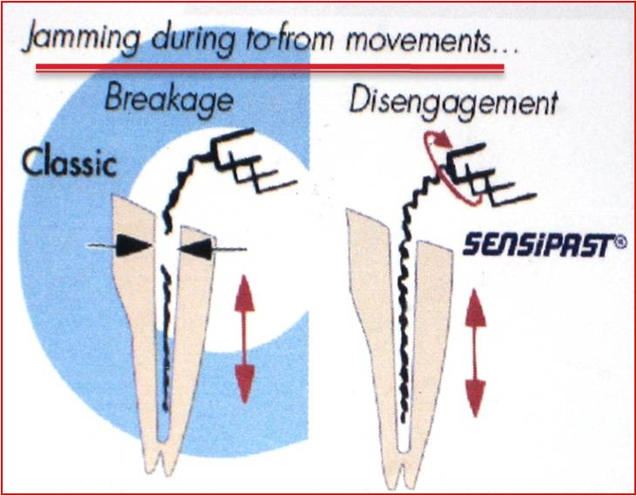
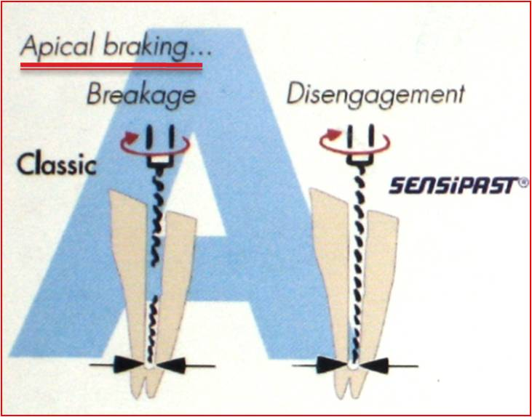
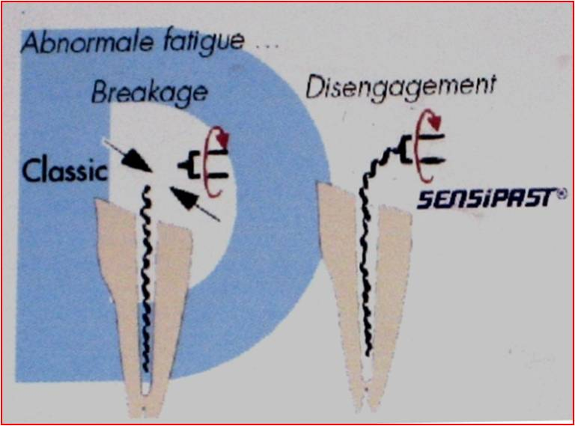
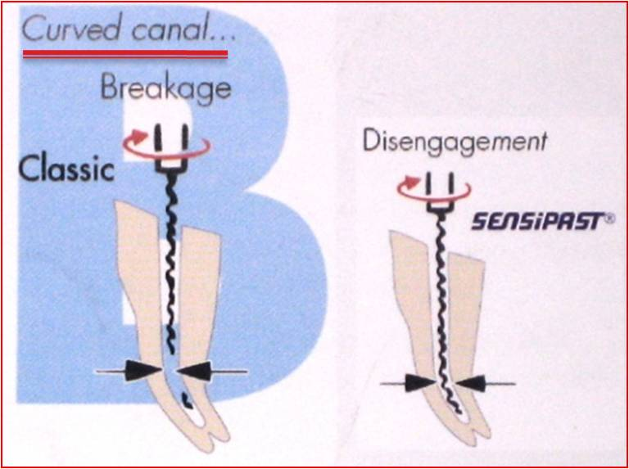
FKG SENSiPAST
Designed to get disengaged at the junction of shank & working end as compared to conventional lentulo spiral which can break at any point

Slide 20
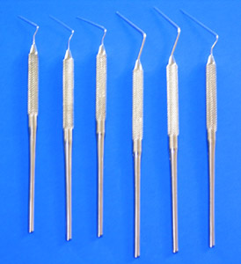
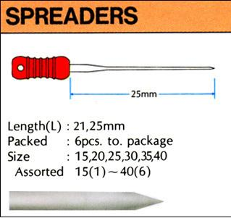
Instruments used for different Obturation techniques
LATERAL CONDENSATION

Slide 21
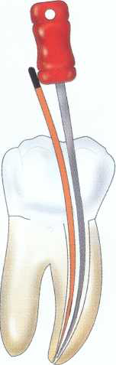
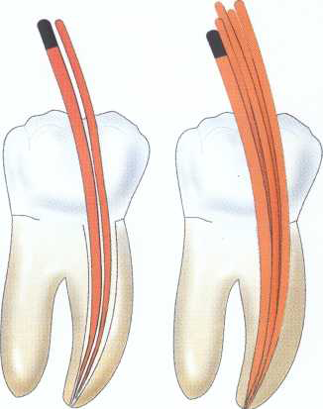
TECHNIQUE FOR LATERAL CONDENSATION

Slide 22
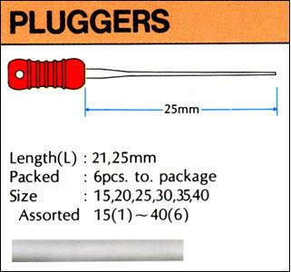
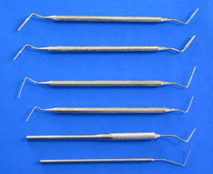
VERTICAL CONDENSATION

Slide 23
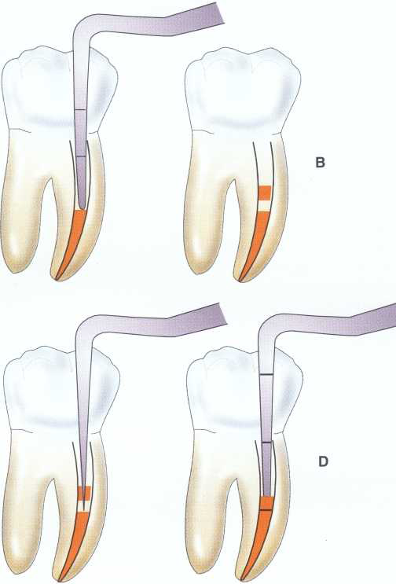
TECHNIQUE FOR VERTICAL CONDENSATION

Slide 24

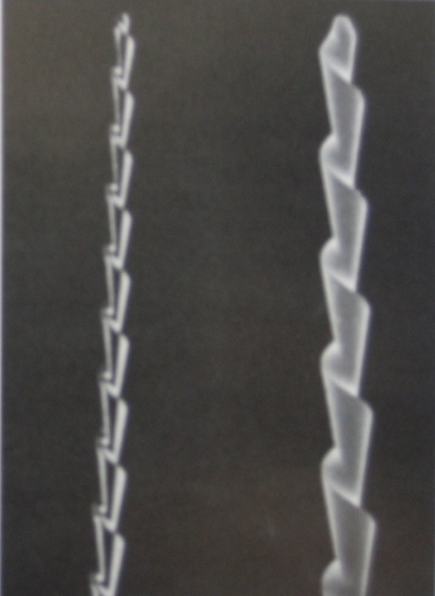
THERMOMECHANICAL COMPACTION
  Mc Spadden Compactor
  Gutta Percha Compactor

Slide 25
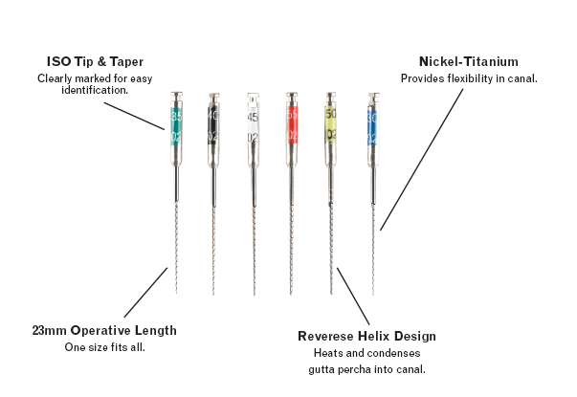
    NiTi Rotary Obturators
    Reverse Helix Design
    Recommended Speed: 8000rpm

Slide 26
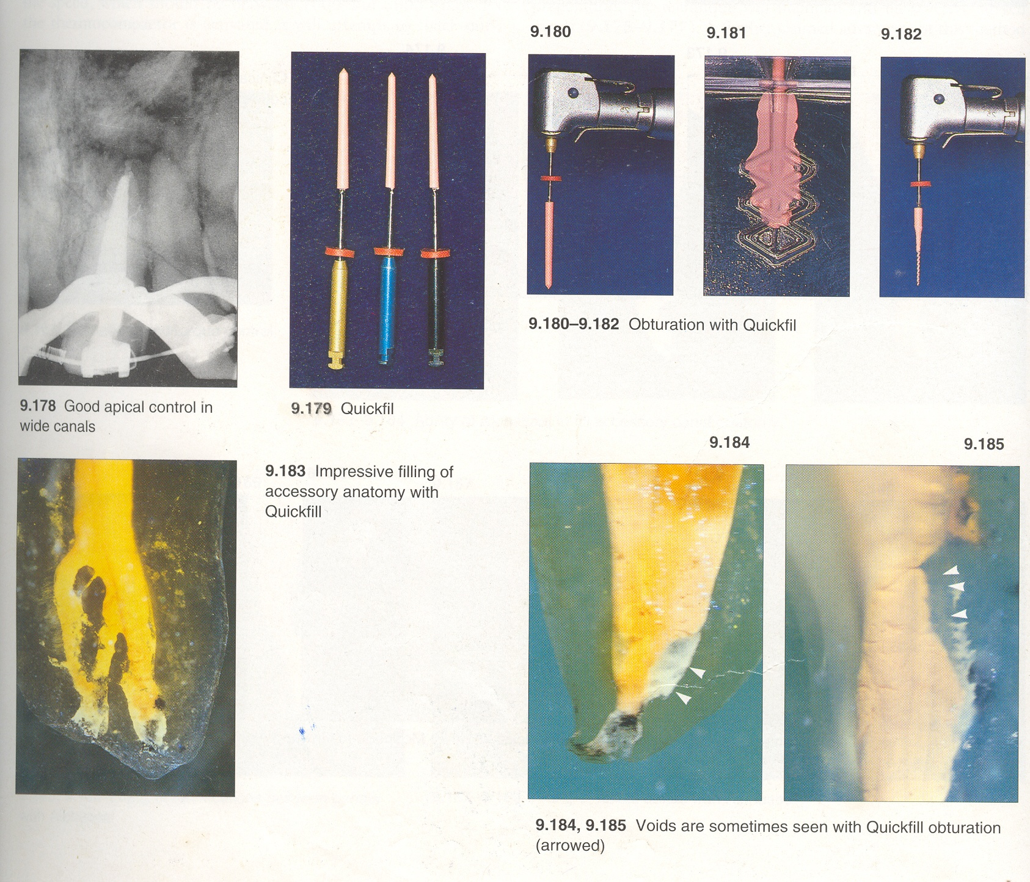
J S QUICK-FILL:
The compacting instrument
is a reverse turning screw which softens
the gutta percha by frictional heat
and compacts it ahead of and
lateral to the rotating shaft.

Slide 27
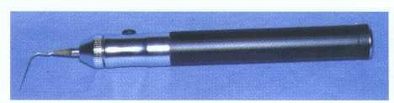
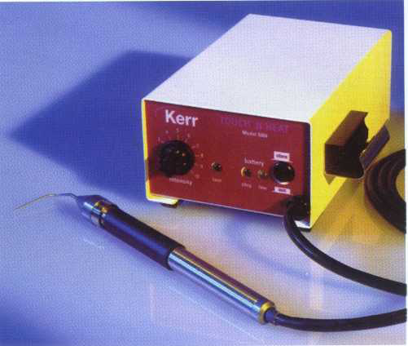
THERMOPLASTICISED TECHNIQUES
Heat Activated Tips
ENDOTEC
TOUCH N HEAT

Slide 28
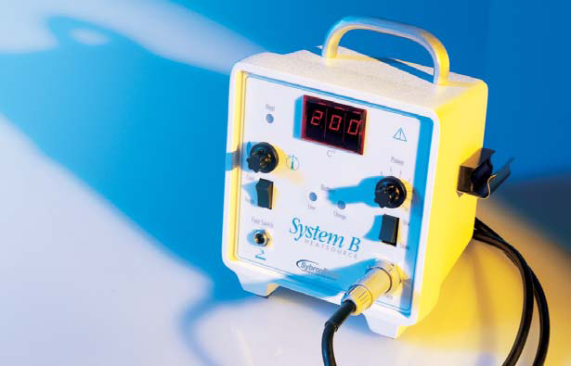
SYSTEM-B

Slide 29
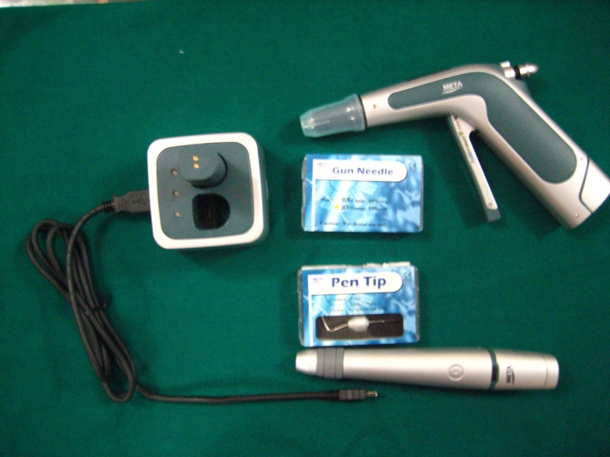
Heat Activated Tips + Backfill with thermoplasticised Gutta Percha
E&Q Plus
E&Q Master

Slide 30
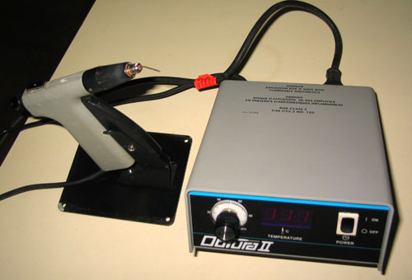
    Injectable systems

Slide 31
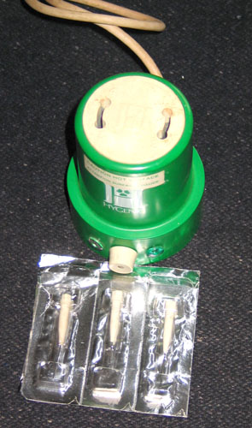
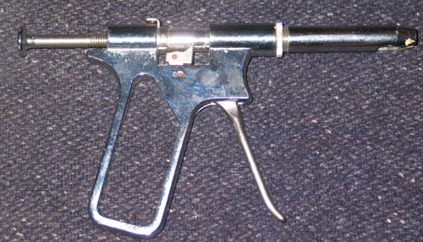

Slide 32
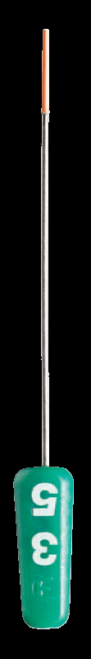
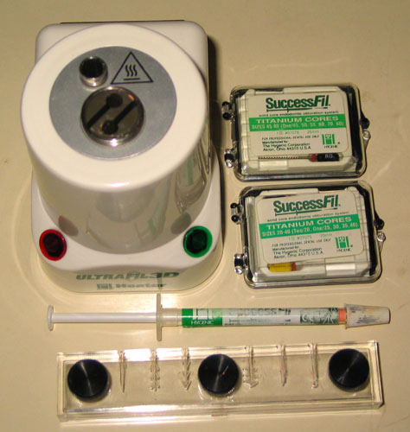
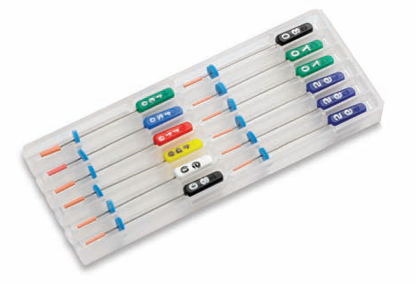
SUCCESSFILL
SIMPLIFILL

Slide 33
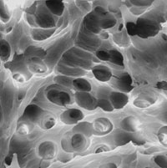
TAKE HOME MESSAGE
From a biological perspective, root canal treatment is directed toward the elimination of micro-organisms from the root canal system and the prevention of reinfection.
Technological advances in the form of rotary NiTi instruments have led to dramatic improvements in the ability to shape root canals with potentially fewer procedural complications.

Slide 34
QUESTIONS
What are various instruments used for obturation of root canal?
Explain lateral condensation technique of obturation?

Slide 35
REFERENCES
Endodontic Practice 11th Edn. Grossman
Pathways Of The Pulp 6th Edn. & 9th Edn. Cohen
Endodontics Vol 1 Arnaldo Castellucci
Endodontics Ingle 5th Edn.
Text book of Endodontology Bergenholtz Reitz
Endodontic Therapy Weine 5th Edition
Color atlas of Endodontics William Johnson
Principles and practice of Endodontics- Walton &Torabinejad
Color Atlas of Microsurgery in Endodontics Syngcuk Kim
Textbook of Endodontics Nisha Garg Amit Garg

Slide 36
THANKYOU

